Slide 1
CMP-5045B: Embedded Systems
Demo: Secure Home System
Student: Harry Yelland
Module Organizer: Edwin Ren
25 May 2021
University of East Anglia
Notes:
Section one takes about ? min.
Section two takes about ? min.

Slide 2
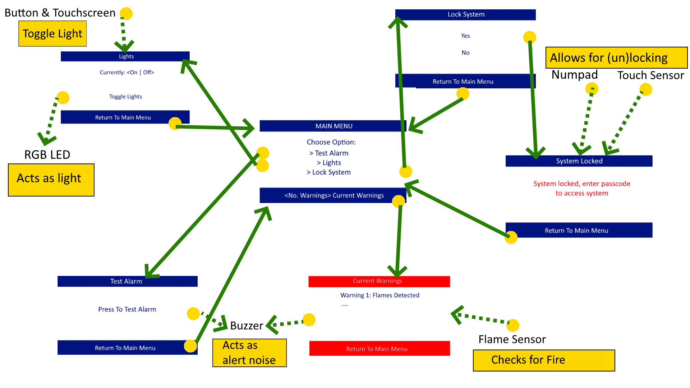
Application Scenario
System functions as a basic home security system that could be extended with further features to enhance functionality.
Adds small home automation functionality into the system to improve on other systems available on the market
Can be used in other building environments if scaled upwards.

Slide 3
Hardware and Software Specification
Hardware
STM32f7-discovery Board (inc. GLCD, Touchscreen)
Button, Touch Sensor, LED
Flame Sensor, Buzzer, Keypad
Software
Board Support: STM32F746G Discovery (v1.1.1)
Keil uVision5 MDK-Lite (v5.17.0.0)
Keil::MDK-Middleware (v7.0.0beta)
ARM::CMSIS CORE (v4.5.0)

Slide 4
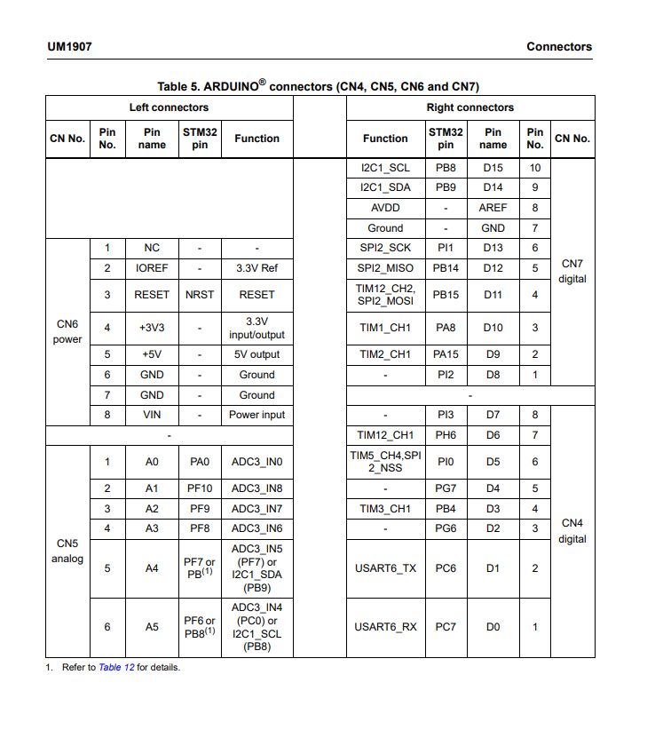
Connections
LED (D0)
Buzzer (D1)
Flame (D2)
Button (D4)
Touch (D5)
Keypad (D7-D15)

Slide 5
GPIO Clock/Pin/Modes
LED – Clock C, Pin 7, Output, Pulldown
Buzzer – Clock C, Pin 6, Output Pulldown
Flame – Clock G, Pin 6, Input Pulldown
Button – Clock G, Pin 7, Input Pulldown
Touch – Clock B, Pin 4, Input Pulldown
Keypad – Clock A Pins 8, 15
Clock B Pins 8, 9, 14, 15
Clock I Pins 1, 2
Input & Output Pulldown

Slide 6
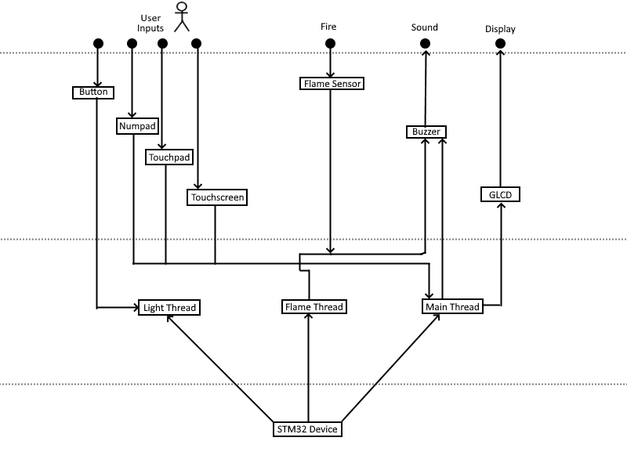
System Architecture

Slide 7
Considerations
Hearing Impairments?
- Can use visual elements to help convey data
Visual Impairments?
- Can use audio elements to help convey data
Mobility Issues?
- Could implement ease-of-access features
- (i.e: light switch on screen as well as physical button)

